Slide 1
Machine Learning with MicrosoftML
Ali Zaidi
Data Scientist
AI and Research

Slide 2
Where’s Waldo?
aka.ms/mml-class
Course Repository
Left Side:
aka.ms/earlml
Right Side:
aka.ms/earlml2

Slide 3
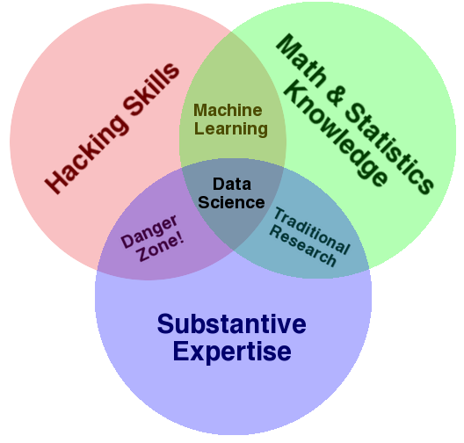

What’s Data Science?
Drew Conway: http://drewconway.com/zia/2013/3/26/the-data-science-venn-diagram

Slide 4
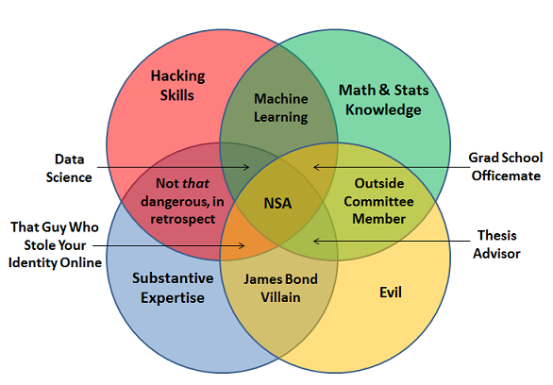
Don’t be Evil!
Joel Grus: http://joelgrus.com/2013/06/09/post-prism-data-science-venn-diagram/

Slide 5
The Dimensions of Scalability – Technologies
Big Data
ADLA
CNTK
Scalability is a continuous spectrum of at least three dimensions
Hadoop/HDInsight
SQL DW
Microsoft ML Server
Scaling up to large data
Cheap/commodity hardware
Fast readers / high throughput
Portability
Spark SQL
XGBoost / LightGBM
Spark ML
Infer.NET
Stan
Big Models
Scaling up to large models
Large memory
Parallelization – CPU plateu
Azure Stream Analytics
Cognitive Services / ML APIs
Scaling up to many models
Fast algorithms
Fast scoring
Compiled architectures
doAzureParallel
Many Models

Slide 6
The Dimensions of Scalability – Use Cases
Big Data
Vision
Robotics/Reinforcement Learning
Scalability means and requires different things depending on the use case
Interactive Querying
Anomaly Detection
Natural Language Processing
BI Dashboards
Enterprise Reporting with Big Data
Fault tolerance
Replicability
Data Compliance/Security
Search
Recommender Systems
Classification
OLTP/OLAP
Hierarchical Modeling
Forecasting
Natural Language Translation
Low Latency
Large memory
Efficient linear algebra libraries
Big Models
IoT
Speech / Translation
Real-Time
Querying
Self-driving cars / mobile assistants
Compressed algorithms
Little/no latency
Many Models

Slide 7
What is R?
Open-source programming language for statistical computing
Free (cran.r-project.org)
Highly extensible
Focused on statistics and machine learning
Transparent and reproducible
Single-threaded
Data stored in memory

Slide 8
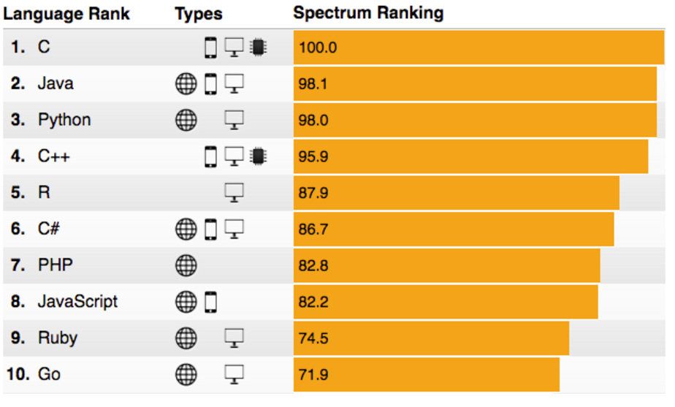
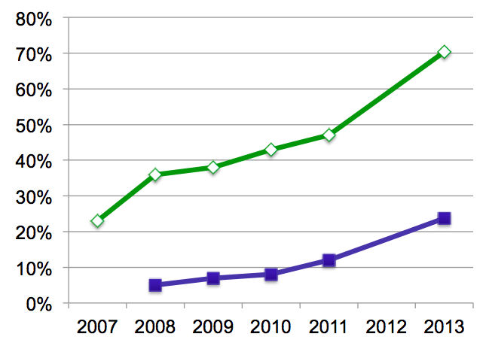
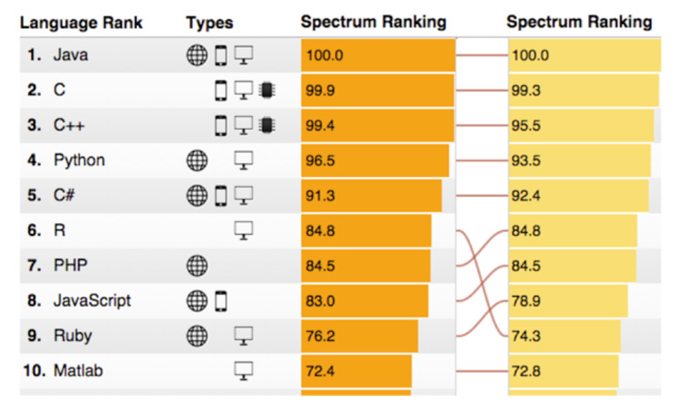
R’s popularity is growing rapidly
Language Popularity
IEEE Spectrum Top Programming Languages
R Usage Growth
Rexer Data Miner Survey, 2007-2013
2015
2014
80%
0%
2007
2008
2009
2010
2011
2012
2013
Primary Tool
Use for Data Science
Rexer Data Miner Survey
IEEE Spectrum 2014 – 2016
Notes:
Slide objective
Introduce the popularity of the R language vs. other analytics languages.
Talking points
R is enjoying an unstoppable wave of popularity
In 2015, it moved from the #9 most frequently used language to #6.
Only general purpose languages are more frequently used than R.
Notes:

Slide 9

What is
Language
Platform
A statistics programming language
A data visualization tool
Open source
Community
2.5+M users
Taught in most universities
New and recent grad’s use it
Thriving user groups worldwide
Ecosystem
10,000+ free algorithms in CRAN
Scalable to big data
Rich application & platform integration
Notes:
Slide objective
Establish that R is a language is as important for the community that uses it an the capabilities written to extend it than the language itself.
Talking points
Part 1 of the R World is The R language, developed specifically for data analysis – particularly among statisticians and mathematicians.
[optional points]:
Developed in New Zealand, release in roughly 2000.
Maintained by the R Foundation which releases new editions of R every few weeks.
Licensed under GPL open source license.
R directly supports complex data manipulation operations making them extremely simple for users, particularly those with greater depth in statistics and mathematics than in computer science.
Huge community of users across industry, government and academia use R daily.
There are R user groups in most major cities. Some of them very active and very large. Suggest that users look at MeetUp for local groups that meet regularly.
Most important to the value of R is the huge repository of freely exchanged, algorithms, techniques, scripts, adapters, techniques, training available.
Introduce CRAN: “The Comprehensive R Archive Network”.
Data access & integration
Data transformation
Data profiling
Data visualization
Predictive analytics
Machine Learning
CRAN contains over 7000 (and growing) contributed packages. Many algorithms, test data, comments on usage, etc. One package contains hundreds of algorithms packaged as a library.
All are designed to run with the R language.
CRAN is the largest but not the only. Thousands of additional algorithms, visualizations and tools are available from BioConductor, GitHub and other repositories.
Notes

Slide 10
Challenges posed by open source R
?
?
$?
Limited Data Scale
Inadequate
Modeling Performance
Lack of Commercial Support
Complex Deployment
Processes
Notes:
Slide objective
Introduce how the use of open source R for machine learning and advanced analytics has been limited to a narrow user base of data scientists. Related to this, also discuss how many challenges and complexities remain for advanced analytics in the marketplace.
Talking points
Today, advanced analytics using open source R are being performed only by highly trained and specialized data scientists, mathematicians, and analysts who can create and nurture these models. This means that many challenges and complexities remain in the marketplace.
First, many companies cannot negotiate the increasing costs of specialized talent, infrastructure, and machine learning tools that make total cost of ownership (TCO) and return on investment (ROI) uncertain.
Second, siloed and cumbersome data management restricts access to data and poses limitations on what data can be included in models.
Third, trying to collaborate across complex and fragmented technologies tends to limit agility and reduce participation in exploring data and building models. People end up struggling with the technology instead of focusing on the business problem at hand.
Finally, many models never achieve business value because it’s so difficult to deploy them to stable production environments. If you can imagine spending hundreds of thousands of dollars on a solution and having it never go into production, you can see why machine learning has been so niche up to this point.
Notes

Slide 11
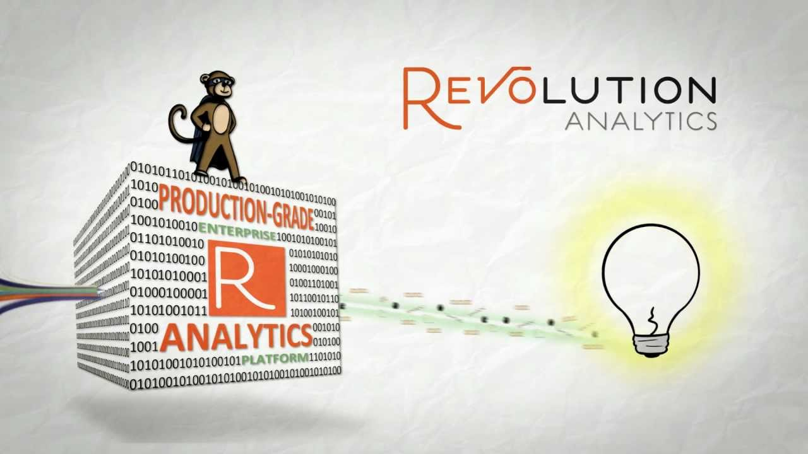
Can R Scale for Scalable Data Science and ML?
Can R handle big data?
GNU-R is in-memory!
Can R handle big models?
GNU-R is single-threaded!
Can R handle many models?
GNU-R is single threaded, can we run many parallel jobs?

Slide 12
Distributions of R
Microsoft R Server
Enterprise-class high-performance analytics distribution
Parallel external memory algorithms with the RevoScaleR library
No threads limits
Out-of memory computation with the XDF file format
Deployment capabilities through the mrsdeploy package
Commercial support
Available in Linux (Red Hat, CentOS), Windows, SQL Server, Spark, Hadoop and Teradata
Battle-tested Microsoft Research libraries for state-of-the-art machine learning with MicrosoftML
CRAN-R
a.k.a., GNU-R
Single-threaded
In-memory
10K+ packages
Interfaces to C++, C, and Fortran for speed
Cross-platform
MRO
GNU-R + Intel MKL = multi-threaded linear algebra
100% CRAN-R compatible
Reproducible R toolkit with the checkpoint package
Open Source
R Client
HPA with the RevoScaleR and MicrosoftML package
Multi-threaded support (two cores)
Deployment with mrsdeploy
Free, Win + Linux
In-memory distributions
Out-of-memory, multicore, multi-node, Parallel Algorithms
Other (re)-Distributions, pqR, supR, ddR, Oracle R, don’t support all CRAN packages

Slide 13
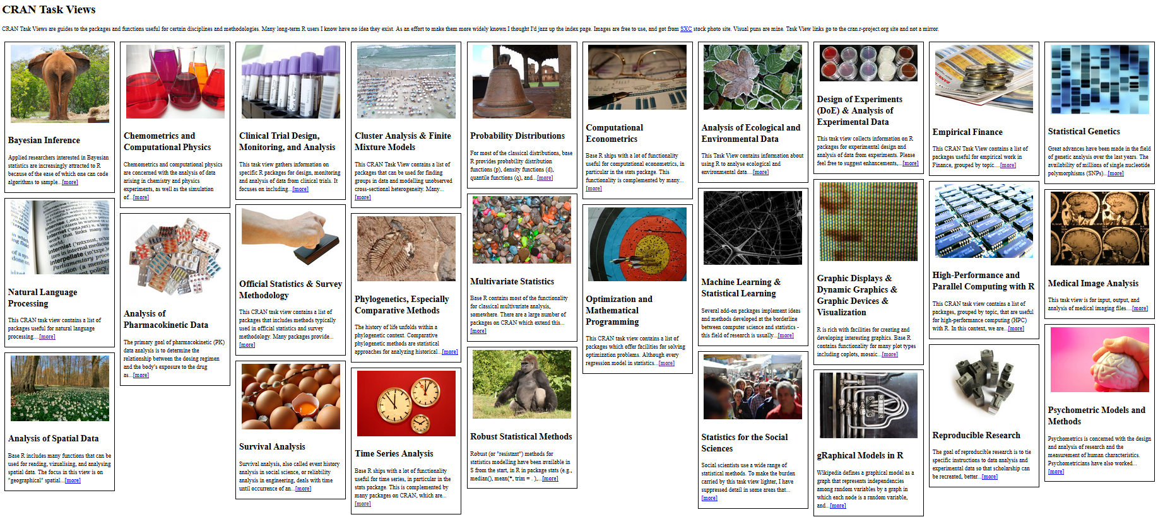
CRAN
The Comprehensive R Archive Network
In addition to CRAN, Bioconductor, GitHub, others distribute R packages
Notes:
CRAN Task View by Barry Rowlingson: http://www.maths.lancs.ac.uk/~rowlings/R/TaskViews/

Slide 14
R from Microsoft brings
Peace of mind
Efficiency
Speed and scalability
Flexibility and agility
Notes:
Slide objective
At a high level, describe the evolution of predictive analytics technology and its current state in the marketplace. Also, introduce the related value proposition of combining the R programming language with the Microsoft data platform.
Talking points
Data is the currency of modern business; from the cloud to on-premises and everything in between, access to data anytime, anywhere from varied sources has become a requirement for successful planning and operation. Today, the R open source programming language enables organizations to move beyond reacting to data after the fact, and begin predicting results and gathering proactive insights to help plan ahead.
Basically, an evolution is taking place.
The rise of machine learning and advanced analytics gives us the ability not only to look at historical data to understand what happened and why, but also to harness predictive analytics to peer into the future. With predictive analytics, we can better understand what is likely to happen and identify what actions should be taken so businesses can automate outcomes.
Again, to date, R has been available only as open source. But now that’s changed, and Microsoft is introducing a new value proposition.
With R from Microsoft, you get:
peace of mind,
Efficiency,
Speed and scalability,
And flexibility and agility.
Notes

Slide 15
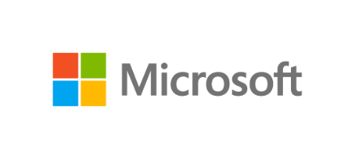
Microsoft R portfolio
Microsoft R portfolio
Community
Commercial
SQL Server
R Services
R Open
R Server
Windows
Linux
Hadoop
Teradata
Spark
Notes:
Slide objective
Show broad commitment to R by preserving freely available, enhanced editions, Windows and SQL Server editions and R Server editions for leading EDWs, Linux and Hadoop platforms.
Differentiate free, open editions from commercial by mentioning availability of commercial 24x7 support, and enhancements to support very large scale data analytics at speed.
Talking points
Notes

Slide 16
Microsoft R Scales to Big Data for Enterprises
Escapes R’s traditional memory limits
Scales predictive modeling using parallelization
Distributes computation cores & nodes
Minimizes data movement using in-database, in-MapReduce and in-Apache Spark execution
f(x)
Notes:
First, Cortana Intelligence provides services to bring data in, so that you can analyze it. It can be any type of data – structured, unstructured, stored in relational or non-relational sources, you name it. This can be data from inside your business, from traditional customer and operations data to IoT data streaming in from devices and sensors. It can also be data from external sources like, social media feeds. That data can be fed into various storage locations, and can be used in whatever downstream analytics and business applications you see fit.
The data brought in can then be stored in flexible big data storage services. Because it’s in the cloud, you can achieve massive global scale, and can easily scale up or down depending on demand. The cloud gives you an almost infinite set of computing resources. This means that you never have to worry about straining your capacity when high-volume events occur, whether they’re planned or unplanned. That might be a peak season of the year, an unexpectedly popular promotion that sets off a social media deluge, you name it. Cloud is key to handling massive amounts of data in a cost-effective way.
And because it’s all in the cloud, you only pay for what you use. This in itself saves you money for anything that has variable computing needs. For some organizations, there is also an additional benefit of changing CapEx to OpEx, which frees up capital from infrastructure investments so it can be put to other uses.
<Transition>: Next, let’s cover analytics.
Slide objective
.
Talking points
.
Notes

Slide 17
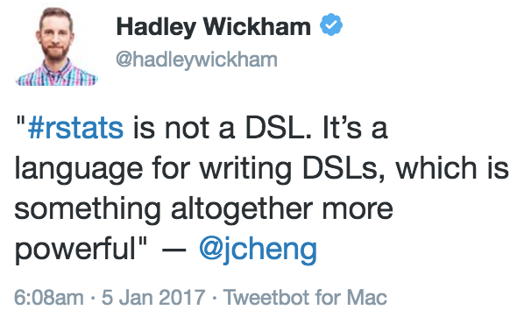
R as an Interface
[Y]ou should understand R as a user interface, or a language that’s capable of providing very good user interfaces
– JJ Allaire, RStudio

Slide 18
Microsoft R Server family
From Data To Action On Premises
Data Sources
People
Cortana Intelligence
+
Apps
Apps
Sensors and devices
Automated Systems
Microsoft R Server & SQL R Services
DATA
INTELLIGENCE
ACTION
Notes:
Slide Objective
Introduce the two product families and transition to high-level product overviews.
Talking Points
Microsoft brings two complementary product lines to bear on the challenges of Advanced Analytics.
Cortana Intelligence Suite provides a rich, end-to-end, cloud-based advanced analytics capability.
Microsoft’s R Server and SQL R Services products leverage a predominantly on-premises point of view – designed for users with significant investments in on-premises data, data repositories, and application portfolios.
Notes
Avoid being dragged into a direct comparison of the two products. There is not a clear answer until much more is known about the audience and their challenges.
If you get dragged into this discussion you may well lose the remainder of your time.

Slide 19
MRS in Different Contexts
On a workstation, that means:
All available cores will be used for math operations and parallel processes
Hard drive capacity sets limit for data size, not RAM
On a cluster:
Parallel utilization of all available nodes
Distributed file systems like HDFS greatly expand possible data sizes

Slide 20
MRS in Different Contexts
Code written on a workstation will run on a cluster by tweaking a single function call:
# Use your local computer:
rxSetComputeContext( LocalParallel() )
# Switch to your cluster:
rxSetComputeContext( RxSpark(...) )

Slide 21
How MRS Works
Parallel External Memory Algorithms (PEMAs)
A chunk/subset of data is extracted from the main dataset
An intermediate result is calculated from that chunk of data
The intermediate results are combined into a final dataset

Slide 22


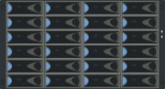



How Does Remote Compute Context Work?
Microsoft R Server “Client”
Microsoft R Server “Server”
Analyze Blocks In Parallel
Load Block At A Time
Big Data
R IDE or command-line
Distribute Work, Compile Results
REMOTE CONTEXT
Work
AlgorithmMaster
Predictive Algorithm
Results
Console
“Pack and Ship” Requests to Remote Environments
Microsoft R Server functions
A compute context defines where to process.
E.g. remote context like Hadoop Map Reduce
Microsoft R functions prefixed with rx
Current set compute context determines processing location
Copyright Microsoft Corporation. All rights reserved.

Slide 23
Available Algorithms
Linear regression (rxLinMod, rxFastLinear)
Generalized linear models (rxLogit, rxGLM, rxLogisticReg)
Decision trees (rxDTree, rxFastTrees)
Gradient boosted decision trees (rxBTree)
Decision forests (rxDForest, rxFastForest)
K-means (rxKmeans)
Naïve Bayes (rxNaiveBayes)
Neural Network (rxNeuralNet)
One-Class Support Vector Machines (rxOneClassSVM)

Slide 24


Parallelized, Remote Execution Algorithms
Data Step
Data import – Delimited, Fixed, SAS, SPSS, OBDC
Variable creation & transformation
Recode variables
Factor variables
Missing value handling
Sort, Merge, Split
Aggregate by category (means, sums)
Statistical Tests
Chi Square Test
Kendall Rank Correlation
Fisher’s Exact Test
Student’s t-Test
Variable Selection
Stepwise Regression
Simulation
Simulation (e.g. Monte Carlo)
Parallel Random Number Generation
Sampling
Subsample (observations & variables)
Random Sampling
Cluster Analysis
K-Means
Descriptive Statistics
Min / Max, Mean, Median (approx.)
Quantiles (approx.)
Standard Deviation
Variance
Correlation
Covariance
Sum of Squares (cross product matrix for set variables)
Pairwise Cross tabs
Risk Ratio & Odds Ratio
Cross-Tabulation of Data (standard tables & long form)
Marginal Summaries of Cross Tabulations
Predictive Models
Sum of Squares (cross product matrix for set variables)
Quantiles (approx.)
Generalized Linear Models (GLM) exponential family distributions: binomial, Gaussian, inverse Gaussian, Poisson, Tweedie. Standard link functions: cauchit, identity, log, logit, probit. User defined distributions & link functions.
Covariance & Correlation Matrices
Logistic Regression
Classification & Regression Trees
Predictions/scoring for models
Residuals for all models
Classification
Decision Trees
Decision Forests
Gradient Boosted Decision Trees
Naïve Bayes
Combination
rxDataStep
rxExec, rxExecBy
PEMA-R API Custom Algorithms

Slide 25
Parallelization Strategies – Many Models
Concurrency requires decomposability
rxExec and foreach are portable backends, so they can be reused in a variety of contexts
Available Backends
doParallel | doMC | doSNOW | CPU threads
doMPI | MPI Ring
RxSpark | Spark Cluster
doAzureParallel | Azure Batch Shipyard
doRedis | Redis Database

